Slide 1
Post operative complications and their management
د صلاح كاظم مسلم
استاذ مساعد . فرع الجراحة
كلية الطب

Slide 2
objectives
INTRODUCTION
➢ DISCHARGE FROM POSTANAESTHETIC RECOVERY
➢ THE FIRST POSTOPERATIVE ASSESSMENT – WHEN
AND WHO?
➢ PROPHYLAXIS
➢ SYSTEM-SPECIFIC POSTOPERATIVE COMPLICATIONS
➢ GENERAL POSTOPERATIVE PROBLEMS
AND MANAGEMENT

Slide 3
INTRODUCTION
○ Aim:
➢ To provide the patient with as quick, painless and safe
recovery from surgery as possible.
○ Postoperative complications may either be general
or specific to the type of surgery undertaken and
should be managed with the patient's history in
mind.
3

Slide 4
ERAS
Enhanced Recovery After Surgery (ERAS®) is the implementation of patient-focused, standardized, evidence-based, interdisciplinary perioperative guidelines²
Guidelines integrate preoperative, intraoperative and postoperative care²
Implementation of Enhanced Recovery Programs reduces postoperative complications, reduces length of hospital stay, with no increase in hospital readmissions⁶

Slide 5
PROPHYLAXIS
○ The following postoperative treatment and
prophylaxis options should be discussed
preoperatively :
➢ Adequate pain control
➢ Venous thromboembolism prophylaxis
➢ Antibiotic prophylaxis
➢ Continuation of current medications
➢ Substitution of current medication (eg diabetic control,
steroid therapy)
Prophylaxis for postoperative nausea and vomiting
➢ Pressure area management.

Slide 6
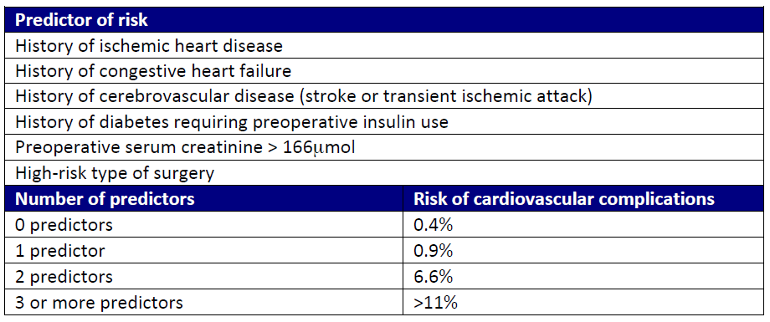
RISK PREDICTORs FOR CV complication

Slide 7
DISCHARGE FROM POSTANAESTHETIC RECOVERY
The patient can be discharged from the recovery
room when they fulfill the following criteria:
➢ Patient is fully conscious.
➢ Respiration and oxygenation are satisfactory
➢ Patient is normothermic, not in pain nor nauseous.
➢ Cardiovascular parameters are stable.
➢ Oxygen, fluids and analgesics have been prescribed.
➢ There are no concerns related to the surgical procedure

Slide 8
The first postoperative assessment should determine:
➢ Intraoperative history and postoperative instructions
➢ Circulatory volume status
➢ Respiratory status
➢ Mental status.

Slide 9
General postoperative complications include:
➢ Postoperative fever
➢ Atelectasis
➢ Wound infection
➢ Embolism and
➢ Deep vein thrombosis (DVT).

Slide 10
Specific complications occur in the following
patterns:
➢ Immediate
➢ Early postoperative
➢ Throughout the postoperative period and
➢ In the late postoperative period

Slide 11
IMMEDIATE
➢ Primary haemorrhage
➢ Basal atelectasis: minor lung collapse.
➢ Shock: blood loss, acute MI, PE or septicemia.
➢ Low urine output: inadequate fluid replacement intra operatively and postoperatively

Slide 12
EARLY
➢ Acute confusion
➢ Nausea and vomiting
➢ Secondary haemorrhage
➢ Pneumonia
➢ Wound infection
➢ Wound dehiscence
➢ DVT
➢ Acute urinary retention
➢ Urinary tract infection (UTI)
➢ Paralytic Ileus

Slide 13
LATE
➢ Bowel obstruction due to fibrous adhesions.
➢ Incisional hernia.
➢ Persistent sinus.
➢ Recurrence of reason for surgery - eg, malignancy

Slide 14
HAEMORRHAGE

Slide 16
Respiratory complications
○ The most common are atelectasis hypoxemia, hypercapnia and
aspiration.
○ Pneumonia and pulmonary embolism tend to appear later in the postoperative period.

Slide 17
POSTOPERATIVE HYPOXIA
○ Hypoxia is defined as an oxygen saturation of less
than 90 per cent.
○ Present as shortness of breath or agitation or as
upper airway obstruction or cyanosis or as a
combination of any of the above.
○ In obese patients or in those with acute or chronic
lung disease, hypoxia develops more quickly

Slide 18
Hypoxia in the postoperative period may occur due to
a variety of reasons, for example:
➢ Upper airway obstruction due to the residual effect of
general anaesthesia,
➢ Laryngeal edema from traumatic tracheal intubation
➢ Atelectasis and pneumonia especially after upper
abdominal and thoracic surgery
➢ Pulmonary edema of cardiac origin or related to fluid
overload.
➢ Pulmonary embolism: this often presents with the sudden
onset of chest pain and shortness of breath.

Slide 19
○ Patients with hypoxia or imminent signs should be
treated urgently.
○ If the patient is breathing spontaneously administer
oxygen at 15 L/min, using a non-rebreathing mask.
○ A head tilt, chin lift or jaw thrust should relieve
obstruction related to reduced muscle tone.
○ Suctioning of any blood or secretions and insertion of
an oropharyngeal airway may be needed.

Slide 20
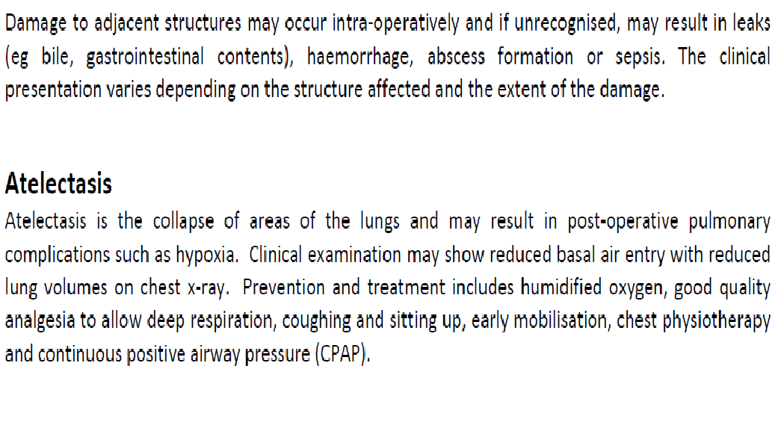
atelectasis

Slide 22
TREATMENT
○ Adequate treatment of pain, anxiety, hypotension and
dehydration will minimise the risk.
○ Administer antiemetics, such as
✓ HT3 receptor antagonists (e.g. ondansetron),
✓ Steroids (e.g. dexamethasone),
✓ Phenothiazines (e.g. prochlorperazine),
✓ Antihistamines (e.g. cyclizine).
➢ At least one antiemetic should be given on a regular
basis in the high risk group of patients and a second
one written up to be given when needed.

Slide 23
RENAL AND URINARY COMPLICATIONS
Postoperative renal failure is associated with high
mortality.
○ Patients with known chronic renal disease, diabetes,
liver failure, PAD and cardiac failure are at high risk.
○ Perioperative events such as sepsis, bleeding,
hypovolaemia, rhabdomyolysis or abdominal
compartmental syndrome can all precipitate acute
renal failure.
Prophylactic measures to prevent renal failure should
be taken in high risk cases.
○ Urinary retention and infection are a common
problem postoperatively.

Slide 24
If urine output is less than 0.5 mL/kg per hour for 6
hours :-
✓ Check that the catheter is not blocked,
✓ Correct hypovolaemia,
✓ Correct metabolic and electrolyte disturbances, and
✓ Stop nephrotoxic drugs.

Slide 25
For UTI:-
○ Treatment involves
✓ Adequate hydration,
✓ Proper bladder drainage and
✓ Antibiotics depending on the sensitivity of the
microorganisms.

Slide 26
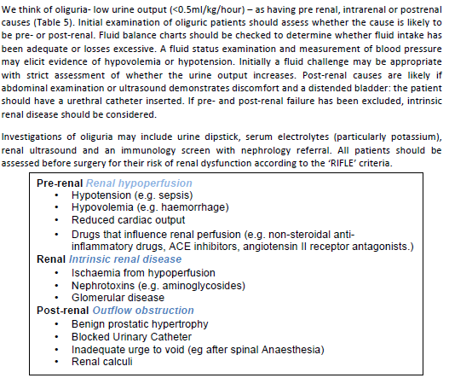
OLIGURIA

Slide 27
HYPOTHERMIA AND SHIVERING
➢ Anesthesia induces loss of thermoregulatory control.
➢ Exposure of skin and organs to a cold operating
environment,
➢ The infusion of cold I.V. fluids all lead to hypothermia.
○ This, in turn, leads to
➢ Increased cardiac morbidity,
➢ A hypocoagulable state,
➢ Shivering with imbalance of oxygen supply and demand, and
➢ Immune function impairment with the possibility of wound
infection.
○ Active warming devices should be used to treat
hypothermia as appropriate

Slide 28
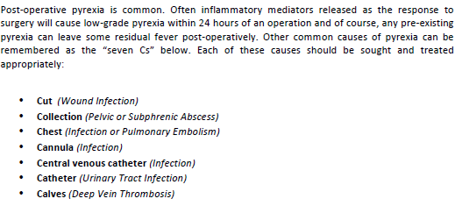
POST-OPERATIVE PYREXIA

Slide 29
POSTOPERATIVE FEVER
Days 0-2:
○ Mild fever (temperature <38°C) (common):
➢ Tissue damage and necrosis at the operation site.
➢ Haematoma.
○ Persistent fever (temperature >38°C):
➢ Atelectasis: the collapsed lung may become secondarily
infected.
➢ Surgical site infection
➢ Blood transfusion or drug reaction

Slide 30
Days 3-5:
○ Bronchopneumonia.
○ Sepsis.
○ Wound infection.
○ Drip site infection or phlebitis.
○ Abscess formation - eg, subphrenic or pelvic,
depending on the surgery involved.
○ DVT.

Slide 31
After 5 days:
○ Specific complications related to surgery
➢ e.g.; Fistula formation.
After the first week:
○ Haemorrhage
○ Wound infection.
○ Distant sites of infection - e.g., UTI.
○ DVT, pulmonary embolus

Slide 32
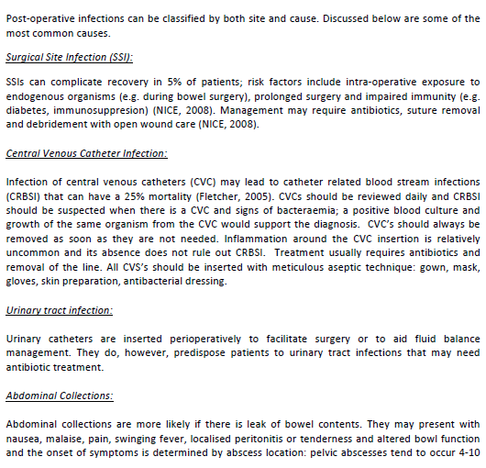
INFECTIONS

Slide 33
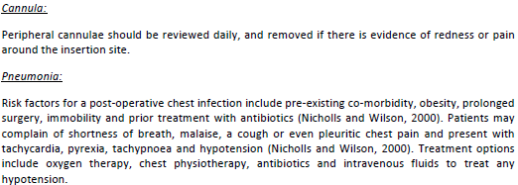

Slide 34
DEEP VEIN THROMBOSIS & PULMONARY EMBOLISM

Slide 35
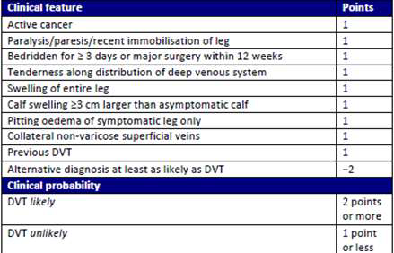

Slide 36
TREATMENT
○ Venography or duplex Doppler ultrasound is used to
assess flow and the presence of thromboses.
○ If a significant DVT is found (one that extends above
the knee), treatment with intravenous heparin
initially, followed by longer-term warfarin, should be
started.

Slide 37
DVT PROPHYLAXIS
○ Most hospitals have a DVT prophylaxis protocol.
○ This may include;-
✓ The use of stockings,
✓ Calf pumps and
✓ Pharmacological agents, such as low molecular weight
heparin

Slide 38
CARDIOVASCULAR DISEASE

Slide 39
Hypotension in the postoperative period can be
multifactorial like:-
✓ Inadequate fluid replacement,
✓ Vasodilatation from subarachnoid and epidural
anaesthesia
✓ Surgical bleeding, sepsis,
✓ Arrhythmias, myocardial infarction, cardiac failure,
✓ Tensionpneumothorax,
✓ Pulmonary embolism,
✓ Pericardial tamponade and
✓ Anaphylaxis

Slide 40
ASSESSMENT OF HYPOTENSION
Observe if:
Awake or easily rousable
○ Comfortable
○ Normal preoperative BP
○ Warm
○ Well perfused (capillary refill
<2 seconds)
○ Heart rate 60-100bpm
○ Passing urine (>0.5 ml/kg/hr)
○ No obvious bleeding
Seek further advice if
Drowsy or unrousable
○ Distressed
○ Hypertensive preoperatively
○ Cold
○ Capillary refill >2 seconds
○ Heart rate >100 or <60 bpm
○ Oliguric (<0.5 ml/kg/hr)
○ Signs of bleeding (drains,
wounds, haematoma

Slide 41
MYOCARDIAL ISCHEMIA AND INFARCTION
○ They commonly present with retrosternal pain
radiating into the neck, jaw or arms and may also
have nausea, dyspnoea or syncope.
○ MI can be STEMI and NSTEMI.
○ However, serum troponin levels will be high in both
types of MI.

Slide 42
Start treatment with
✓ Oxygen,
✓ Glyceryl trinitrate,
✓ Morphine and aspirin , and
✓ Involve a cardiologist.
○ Beta-blockers and/or calcium antagonists may be
started to reduce further episodes of ischemia.

Slide 43
REDUCED BOWEL FUNCTION( ileus)

Slide 44
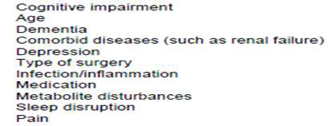
DELIRIUM

Slide 45
Can occur on recovery from anaesthesia
(postoperative delirium (POD)) or a few days after
surgery.
○ Incidence of POD is 5–15 per cent, but is higher in the
elderly with hip fractures and is associated with
increased morbidity and mortality

Slide 46
PRESSURE SORES

Slide 47
WOUND DEHISCENCE
○ Wound dehiscence is disruption of any or all of the
layers in a wound.
○ Occur in up to 3 per cent of abdominal wounds and is
very distressing to the patient.
○ Occurs from the 5th to the 8th postoperative day when
the strength of the wound is at its weakest.
○ The patient may have felt a popping sensation during
straining or coughing.

Slide 48
RISK FACTORS IN WOUND DEHISCENCE
General
○ Malnourishment
○ Diabetes
○ Obesity
○ Renal failure
○ Jaundice
○ Sepsis
○ Cancer
○ Treatment with steroids
49

Slide 49
Local
○ Inadequate or poor closure of wound
○ Poor local wound healing, e.g. because of infection,
haematoma or seroma
○ Increased intra-abdominal pressure, e.g. in
postoperative patients suffering from chronic
obstructive airway disease, during excessive
coughing.

Slide 50
Most patients will need to return to the operating
theatre for resuturing.
○ In some patients, it may be appropriate to leave the
wound open and treat with dressings or vacuumassisted
closure (VAC) pumps.

Slide 51
KEY POINTS

